Slide 1

Hippo Hacks 2019 Hippo Hacks 2019
Improvement for Google Map
Group Members:
Hyunjae Yu
Xiaodan Chen
Xiaochi Li
Yupeng Yang

Slide 2
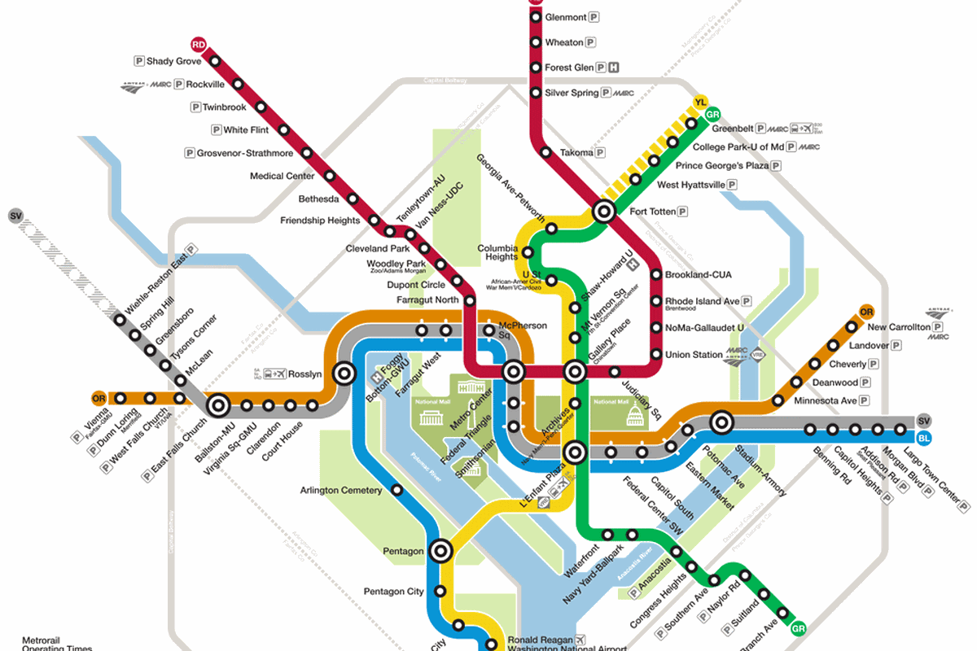
Problem Statement
Each of us have used one or more of the many transit options in Washington, DC, such as subway, bus, bicycle, etc.
As city bicycles become increasingly popular, we realize Google Map hasn’t created a trip method by combination of Metro and bicycles.
It’s time to find out how to travel using Bicycles + Metro!

Slide 3

Dataset Sources Description
Google Map API (https://developers.google.com/maps/documentation/javascript/tutorial)
Capital Bikeshare (https://gbfs.capitalbikeshare.com/gbfs/gbfs.json)

Slide 4
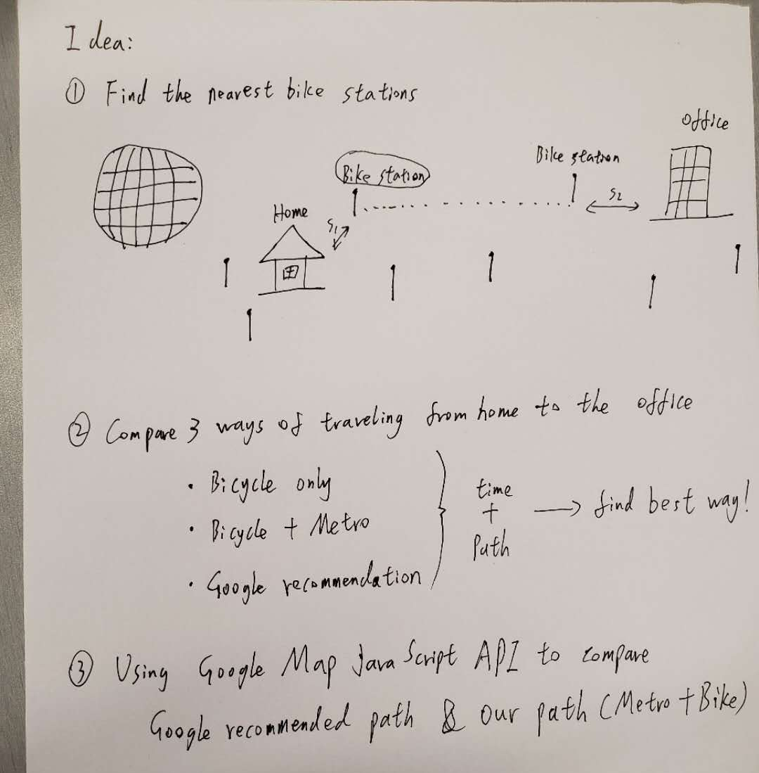
Our Idea:

Slide 5
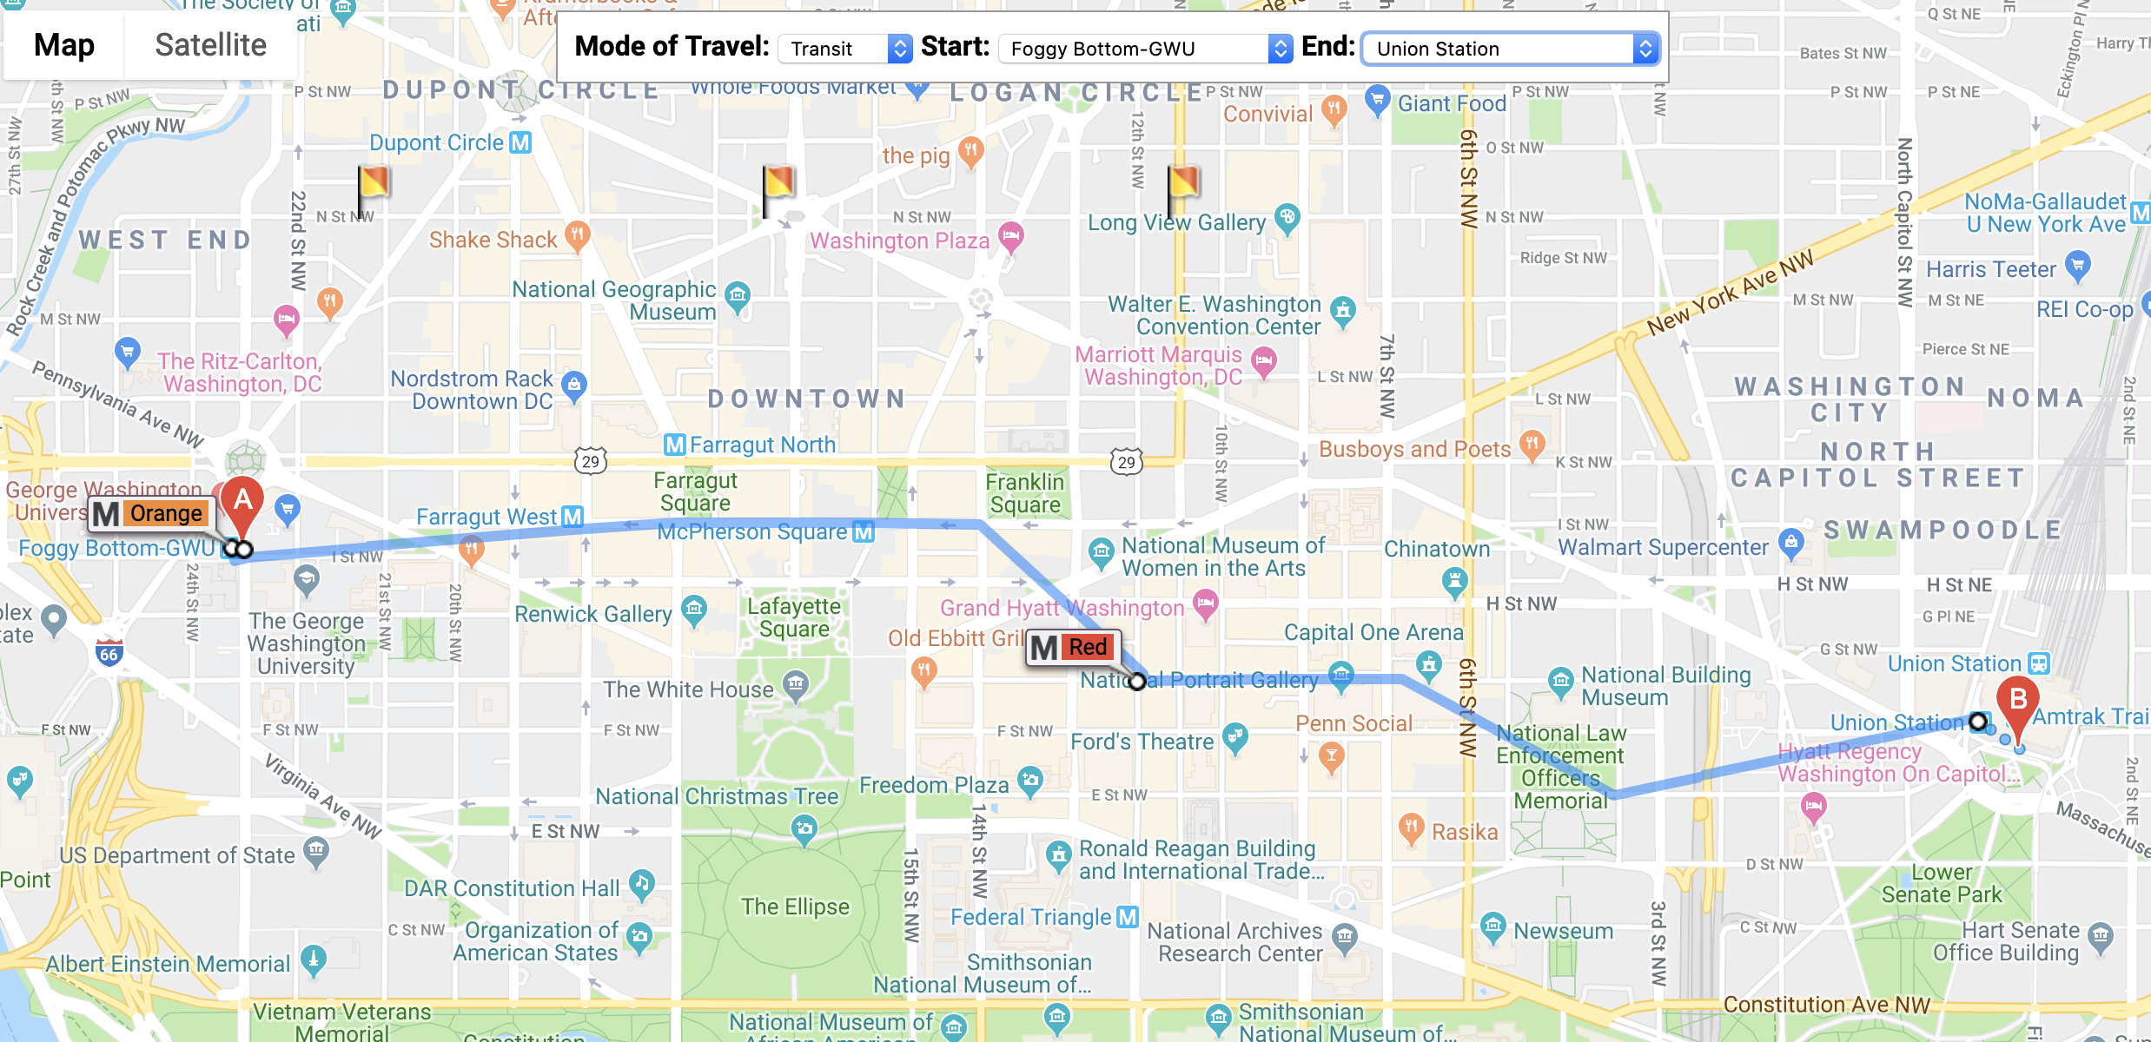
Example: from GWU to Union Station

Slide 6
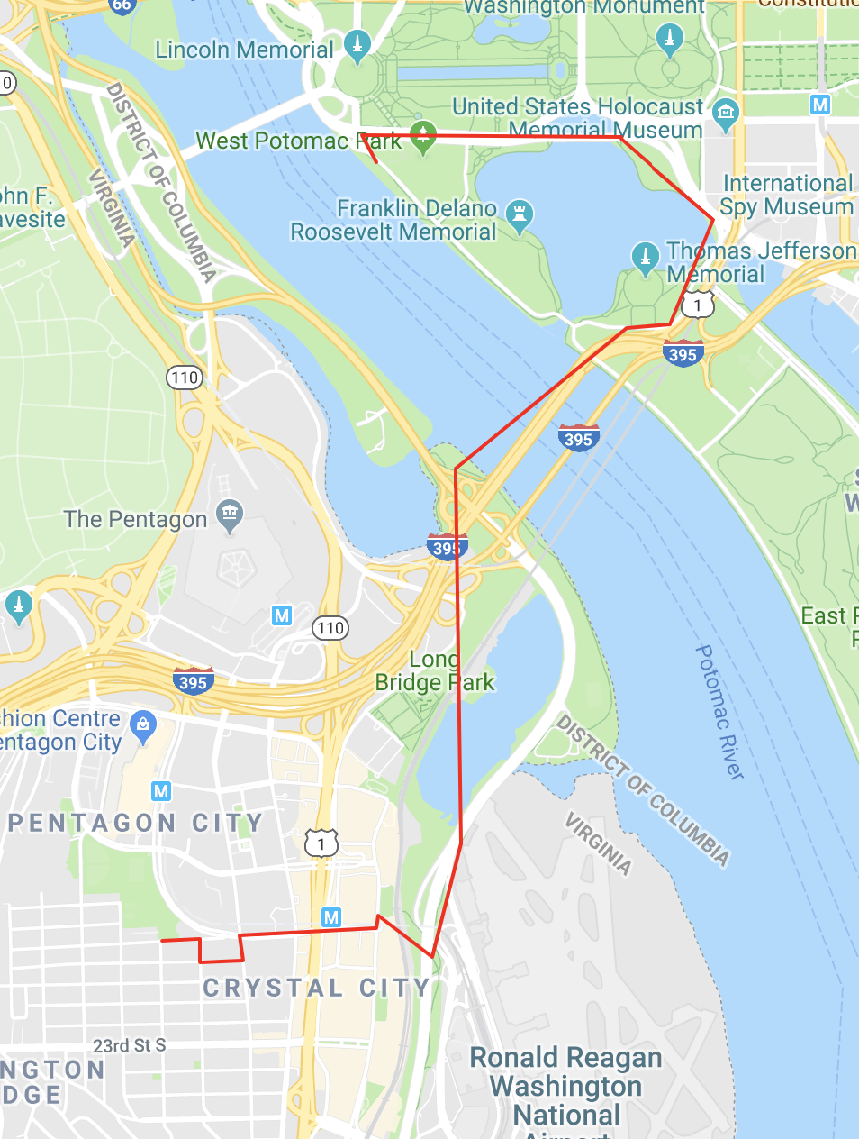
Example: from Crystal City to DC

Slide 7
Thank You

